Slide 1
NCI Research to Reality Mentorship Program
Evidence-Based Public Health
Foundations Training
September 22, 2011
R2R Mentorship Kick-off Meeting
Bethesda, MD

Slide 2
Overview
Hope Krebill Cam Escoffery

Slide 3

Session Objectives
Discuss what is meant by “evidence”
Define the term evidence-based programs, policies or strategies (PPS)
Discuss benefits of using evidence-based programs, policies or strategies
Identify where to go for resources
Notes:
Evidence-based health promotion is an emerging area – addressing the spectrum of program planning, development and evaluation.
This is an evolving discipline – there are many perspectives and resources.
Our intent is to help organizations use what works to improve the health of communities.
During this session we will:
Discuss what is meant by “evidence”
Define the term evidence-based programs, policies or strategies (PPS)
Discuss benefits of using evidence-based programs, policies or strategies
Identify where to go for resources

Slide 4


What is Evidence?
“ the available body of facts or information indicating whether a belief or proposition is true or valid”
In public health practice, a collection of
Data or scientific evidence (guidelines)
Input from community members
Input from other stakeholders
Professional experience
Brownson RC, Baker EA, Leet TL, Gillespie KN, Evidence-Based Public Health. New York: Oxford University Press; 2003
Notes:
Today we are entering into a set of presentations about evidence-based programs, with a variety of understandings and a variety of contexts. The purpose is to enter into the conversation that will last the next year and a half as you plan and implement your projects with the best evidence available in order to increase your potential for success.
The idea of evidence-based was first thought of in the terms of evidence-based medicine, it now seems to have hit the air waves and we hear it mentioned all the time in a lot of different contexts.
I put the term into Google and received over 22 million hits. Even one called ‘Evidence-based Mummy’ child and parenting psychology for the sleep deprived and another one titled ‘evidence-based marketing’.
On this slide we have a couple of books available through Amazon. One is about evidence-based public health the other evidence-based management to improve company performances.

Slide 5
What Is Evidence?
Surveillance Data
Systematic Reviews of Multiple Intervention Studies
An Intervention Research Study
Program Evaluation
Word of Mouth
Personal Experience
Practice Based
Research Based
Notes:
5
There are several levels of evidence – and you really need all types to do your work
Evidence can be based on fact (objective) or opinion (subjective)
Surveillance Data (what would this include?)→ Breast cancer statistics: incidence and mortality
Examples: Cancer registry statistics, CENSUS.
Systematic Reviews:
A review of studies/journals for a specific situation/question-
Example: In The community guide client reminders are recommended to increase breast cancer screening.
Intervention Research Study: (any examples of this in your community?) A single study about the results of using a program or intervention – PLANET, journals
Should be peer-reviewed and published in a peer-reviewed journal.
Program Evaluation: a program that has not had a formal peer review like in a journal; but one that your grantees will be using and you would want to work with your grantees on
Word of mouth from colleagues or volunteers : Quote or personal experience with the program
You will be getting some of this from your community profile.
Personal experience with programs- Key Informant Interviews
One example I have demonstrates the need to include practice-based evidence with the research-based evidence. My example is a medical one. One clinical trial that I was involved in promoting to a rural clinical trial network required a 7 day in a row treatment. Turned out this trial was not a good fit with the network as the community cancer centers are not open 7 days a week. Importantly, this would impact who would be able to use the new treatment if it is found to be effective. You may have other public health examples.
5

Slide 6
Different Types of Public Health Approaches
Strategies
Policies
Environment
Programs
Notes:
Public health addresses health problems through multiple approaches including strategies, policies, programs and environmental change. Strategies can encompass all of those different approaches.

Slide 7

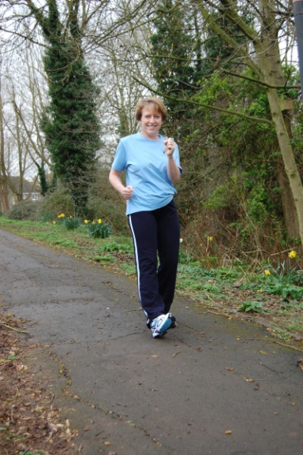
Strategy
Broad intervention that changes individual, systems within organizations, or the community
Infrastructure strategies: changes to the organization or system
patient reminders for screening with electronic medical records
Environmental strategies: alter the physical or social environment
walking trails
Notes:
A strategy is a broad intervention that changes individual, systems within organizations, or the community
Infrastructure strategies: changes to the organization or system: patient reminders for screening with electronic medical records
Environmental strategies: alter the physical or social environment walking trails
One of the proposed projects is for reminders in partnership with insurance companies, primary care physicians, and quality assurance organizations.

Slide 8

Program
A specific intervention and its components
Body and Soul: encourages church members to eat a healthy diet rich in fruits and vegetables every day for better health
Specific components:
pastoral leadership
educational activities
a church environment that supports healthy eating
peer counseling
Notes:
Programs are specific and often package interventions. They have the activities and materials outline for someone to adopt and implement.
Implementation of Body & Soul Program is one of the mentee projects. One area that will be looked at is how to disseminate across a large number of community churches with fidelity (implementing as intended/evaluated by the developer).

Slide 9


Policy
A system of laws, regulatory measures, courses of action, and funding priorities concerning a given topic
Policy: regulation set by government or local authorities (e.g., laws, ordinances)
policy: organizational rule or regulation (e.g., worksite)
Notes:
Define policies
Policies can be more laws at the national, state or local level.
Policies (small P) can also be rules or guidelines set within organizations.

Slide 10
Question
What do you think of when you hear the term “evidence-based”?
Notes:
Ask participants to take 1–2 minutes to write down their responses to this question. Follow up by asking for volunteers to share their responses.
Afterwards, post the definition.
write their definitions on the memo board or flipchart to refer to during the discussion.
10

Slide 11
The Simple Answer
An evidence-based program has been:
Implemented
Evaluated
Found to be effective
Tip – Make sure your partners/collaborators have the same understanding of the term “evidence-based.”
Notes:
What we mean by “evidence-based” has to do with social science rather than clinical practice:
– An evidence-based program has been conducted with a group. It was found to be effective through some type of evaluation.
– These programs and their evaluations have also been reviewed by experts in the field. This is often known as peer review.
– evidence-based practice incorporates
Practice that is based on what we know works rather than what we think works.
And that evidence-based promotion involves
Practice that is oriented to meeting community needs through community partnerships and within community and environmental contexts. This is a much bigger approach to practice than our traditional ways of focusing on individuals only.
11

Slide 12
What is Evidence-Based Cancer Control?
“...the development, implementation, and evaluation of effective cancer education and screening programs through systematic uses of data and research information, and appropriate use of theory-based program planning models.”
Adapted from Brownson et al., J Public Health Management Practice 1999,5:86-97

Slide 13

Your Experience
What has your experience been with evidence-based programs?
Where have you heard of them before?
Have any of you used these programs in the past?
Notes:
Think about the experience that you have had presenting the idea of evidence-based to community partners. How was it received?
Sometimes it may be helpful to approach the idea of evidence in stages. First find out what the community is currently doing to improve the health of their members. Often they are using strategies that have been shown to be effective not just in their practice but also through larger evaluations. It may be helpful to hold a conversation about their successes, how they chose their current approaches and how they determine if it is working.
One of the mentee projects is to help to adapt and implement the Witness Program with the hope that it will remain long term. I believe that is our goal for many to implement a sustainable program. Sustainability can be increased through collaboration. The partnership starts at the beginning, through learning each others language, and forming agreements about the approach.

Slide 14
Advantages of “EBPs”
Demonstrated to work in the study populations
Cost-effective
Shortens development time
Can reduce research time
Can help focus the evaluation
Notes:
Advantages
– An evidence-based program is not always completely effective. However, we promote the use of these programs because we know that they had some effect on the community in which they were conducted. Therefore they are a good starting place.
– Most evidence-based programs have been successful in the groups and settings in which they were studied.
- Adapting an evidence-based program can be easier than creating a new program with similar objectives.
– It can also be more cost effective to use one of these programs than to develop a new program.
• At the very least, evidence-based programs:
– Shorten the development process
– Reduce the need for formative research
– Help narrow the evaluation questions.
MORE ADVANTAGES:
Organization is successful sooner
Creates a clear vision of how best to use resources
Presents new ideas for consideration that could work well
Adds value to a grant application
Increased certainty of success
Saves time and resources during planning and implementation
14

Slide 15
Question
What are some perceived barriers to using evidence-based programs?
Notes:
Ask participants to take 1–2 minutes to write down their responses to this question. Follow up by asking for volunteers to share their responses.
Afterwards, write their responses on the memo board or flipchart to refer to during the discussion.
15

Slide 16
Perceived disadvantages to adopting Evidence-Based Programs
Perceived barriers
Possible solutions
Ownership/ creativity limits
Cost
Too scientific
My community is unique, an EBP will not be appropriate for this audience
Customize/ Brand
Do less formative research
Pick a program that fits your budget
Use the evaluation of EBP
Adapt, Adapt, Adapt!
Notes:
• Using evidence-based programs limits creativity.
– You can be creative by changing the reading level to fit your communities’ needs or making the language more culturally relevant. You can also add the logo or brand of your agency.
In fact, it is expected that programs will need some adaptations like how promotion materials and handouts are worded, or what types of social activities might be most appealing, or even what the program is actually called. So these adaptations can allow for creativity and a homegrown look, provided the essential, core components of the program’s activities, scripts, staff training, and facility and equipment needs are adhered to.
• Evidence-based programs take too much time and/or money.
– Different programs take different resources.
– You can spend less time on formative research. Although it is recommended, you do not need to pilot test the program.
I do not know what evidence –based programs are or where to find them.
– You will learn how to pick a program that will work for your community and also fits your budget and staff.
And another challenge in ebhp is figuring out exactly which programs are evidence-based and what types and how much evidence is enough to say the program provides positive benefits and should be implemented.
Evidence-based programs are too scientific.
– You will learn how to evaluate the success of your program. You can use the methods of the original program.
– “Evidence-based” means that peer-reviewed research and evaluation have already been done on the program. This is what allows us to say it is effective. You may not have to evaluate the program to the same degree.
• My community is unique. An evidence-based program will not be as appropriate as if I developed the program myself.
– We will show you how to adapt a program to fit your community’s specific needs. We can show you how to do this using a case study.
– Often what makes the program effective is not seen by just looking at the products. By speaking with the program developers, you can see if their program might work for your community.

Slide 17
Resources for Evidence Programs
Guide to Community Preventive Services
Agency for Healthcare Research and Quality (AHRQ)
Cancer Control P.L.A.N.E.T.
Research-Tested Intervention Programs (RTIPs)
National Registry of Evidence-based Programs and Practices (NREPP)
See UWW Module 3 - Handout #3: Alternative Sources for Evidence-Based Programs—
http://cancercontrol.cancer.gov/use_what_works/mod3/Module_3_Handout_3.pdf
Notes:
These are some general sources for evidence that we will review over the next few minutes.

Slide 18
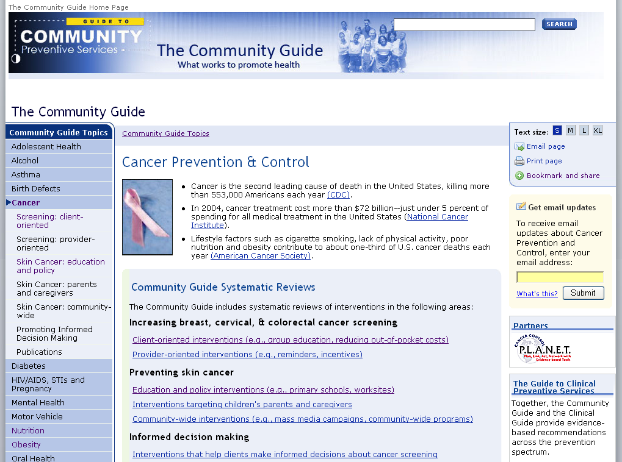
Notes:
The Community Guide is developed by a Taskforce of public health agencies and members that summarize evidence-based policies and strategies.

Slide 19
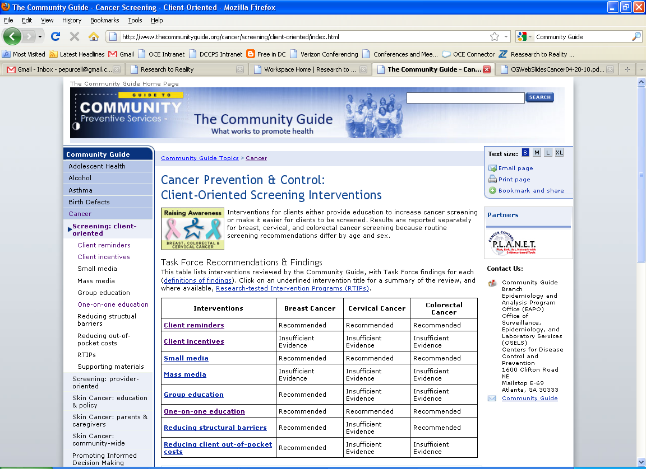
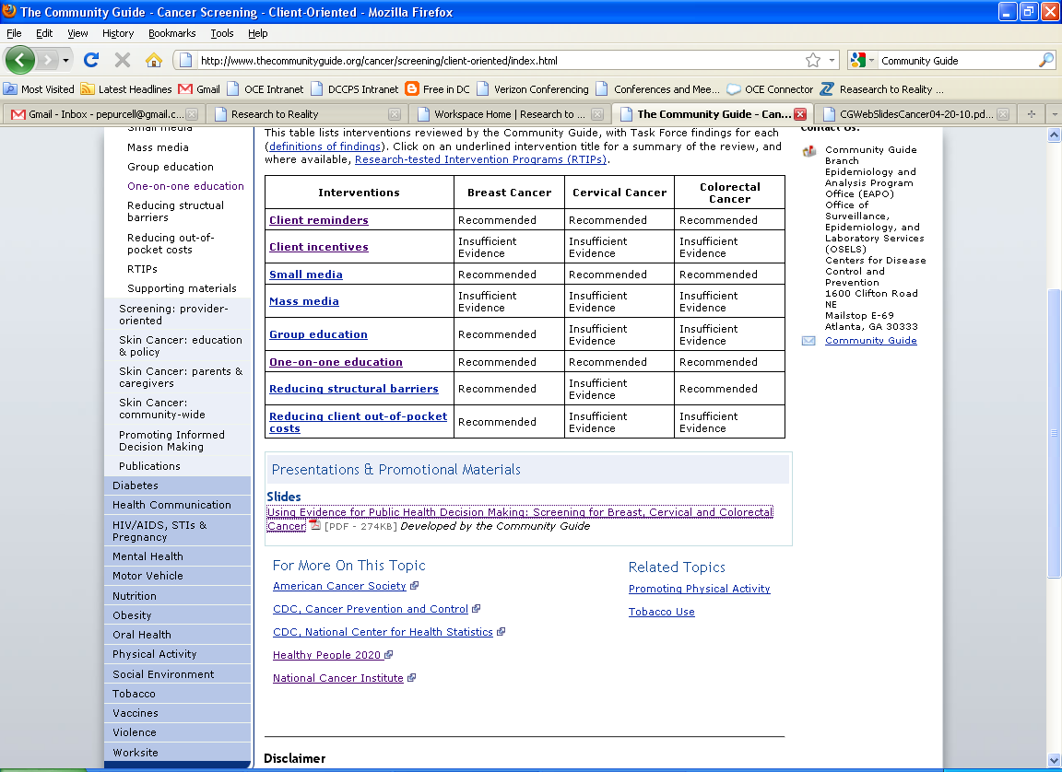
Notes:
This summary table presents the recommended intervention strategies to increase cancer screening.
Please note that insufficient evidence does not mean that that strategy does not work but that there needs to be more research or studies before they can say that it works or does not work

Slide 20
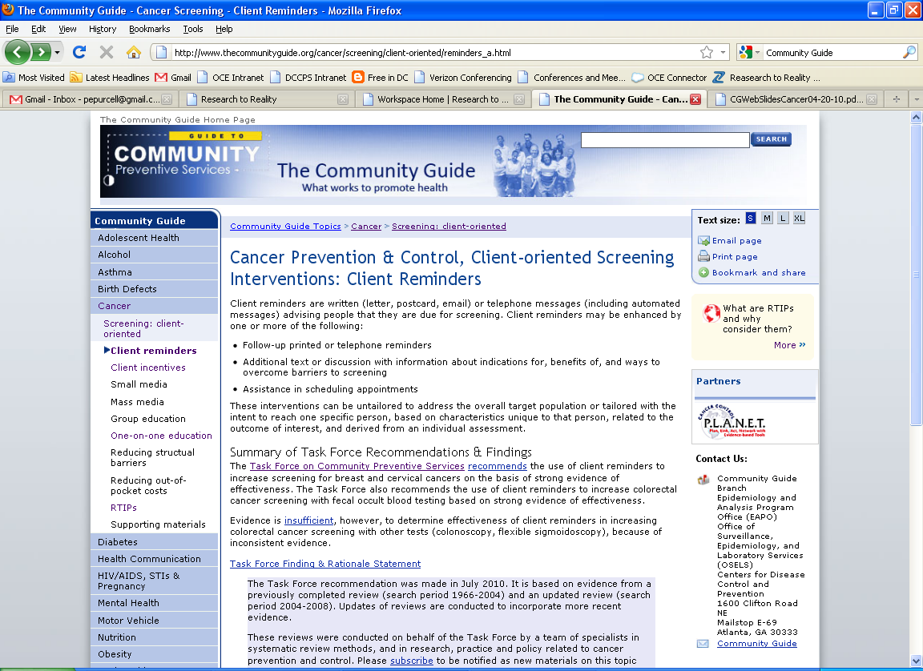
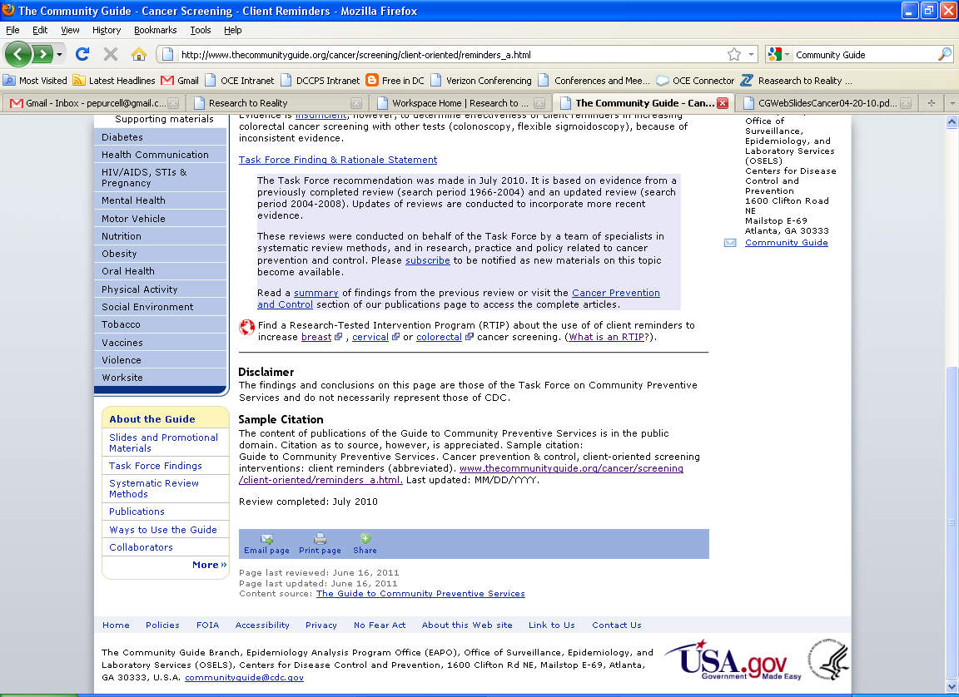

Slide 21
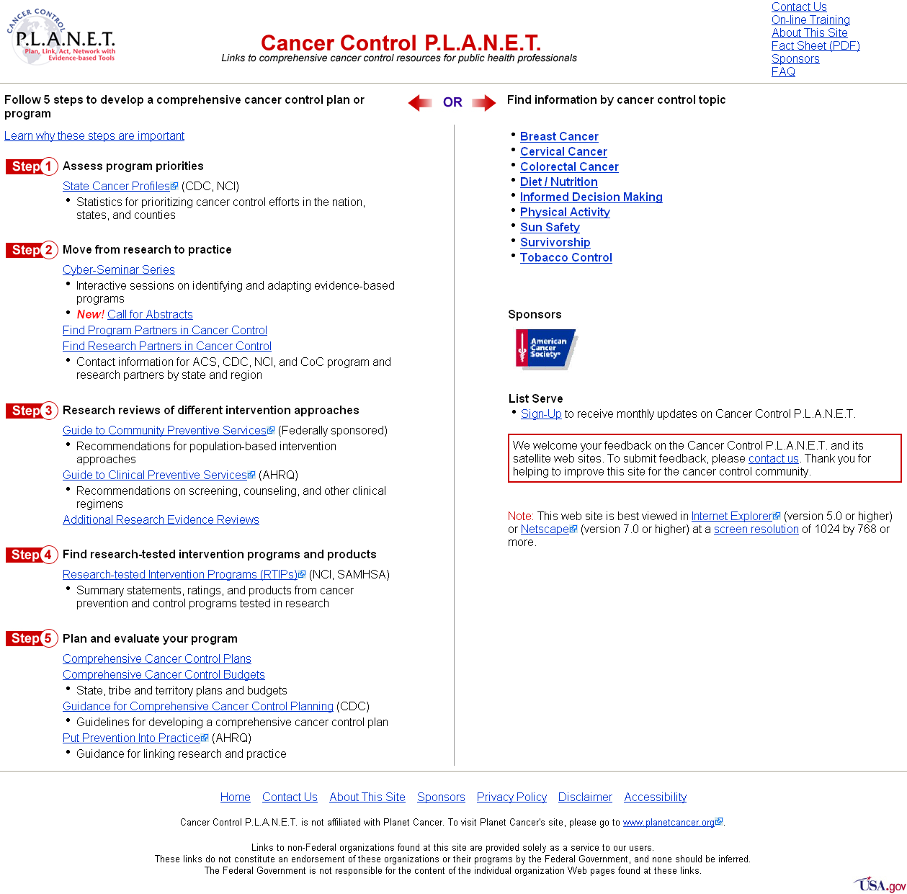
http://cancercontrolplanet.cancer.gov

Slide 22
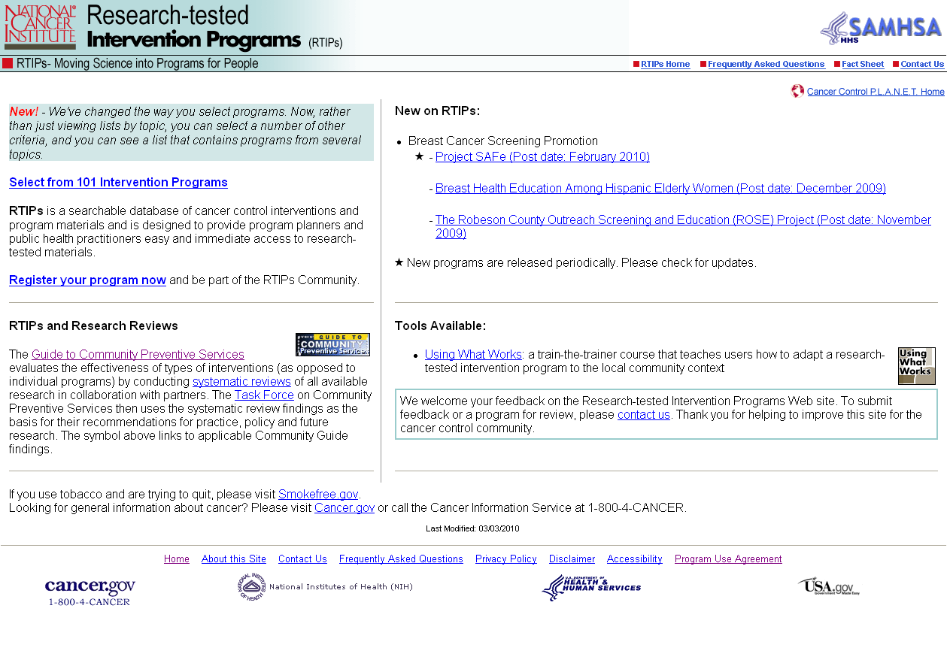
Notes:
RTIPS is a source for evidence-based programs. These have been evaluated or research tested and the materials are available for practitioners to use at low or no cost.

Slide 23
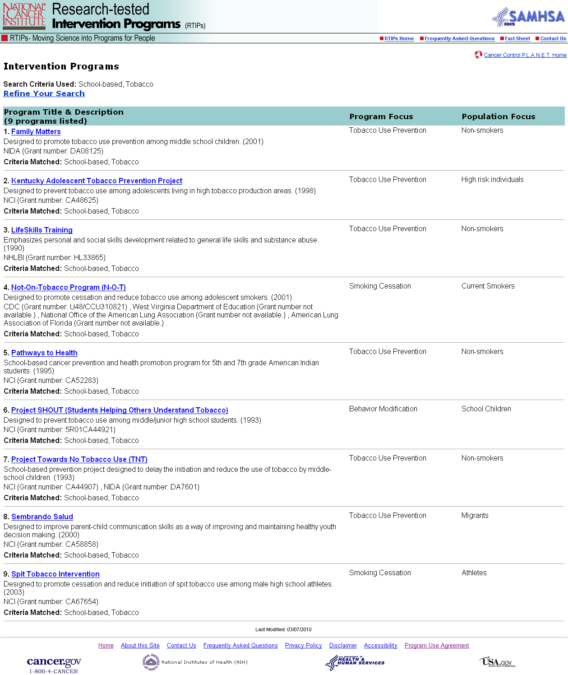
Notes:
Programs are listed on Cancer Control P.L.A.N.E.T. if they are
1. cancer control intervention programs that have research findings that have been published in a peer-reviewed journal
2. the study must have produced one or more positive behavioral and/or psychosocial outcomes (p≤.05) among individuals, communities, or populations 3. the evidence of outcomes must be demonstrated in at least one study, using an experimental or quasi-experimental design 4. have messages, materials and other intervention components that can be used in a community or clinical setting are posted on this site with the approval of the principal investigator 5. the intervention study has been conducted within the last 10 years

Slide 24
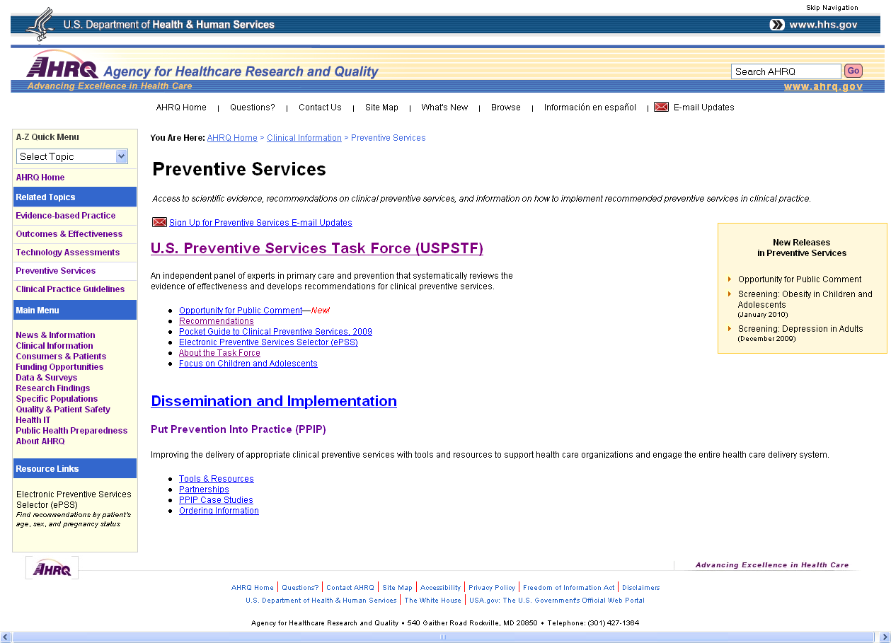
http://www.ahrq.gov/clinic/prevenix.htm
Notes:
AHQR has list of clinical practice guidelines. These are for providers in their public health practice.
U.S. Preventive Services Task Force (USPSTF)
The USPSTF is a Congressionally mandated, independent panel of experts in primary care and prevention that systematically reviews the evidence of effectiveness and develops recommendations for clinical preventive services.

Slide 25
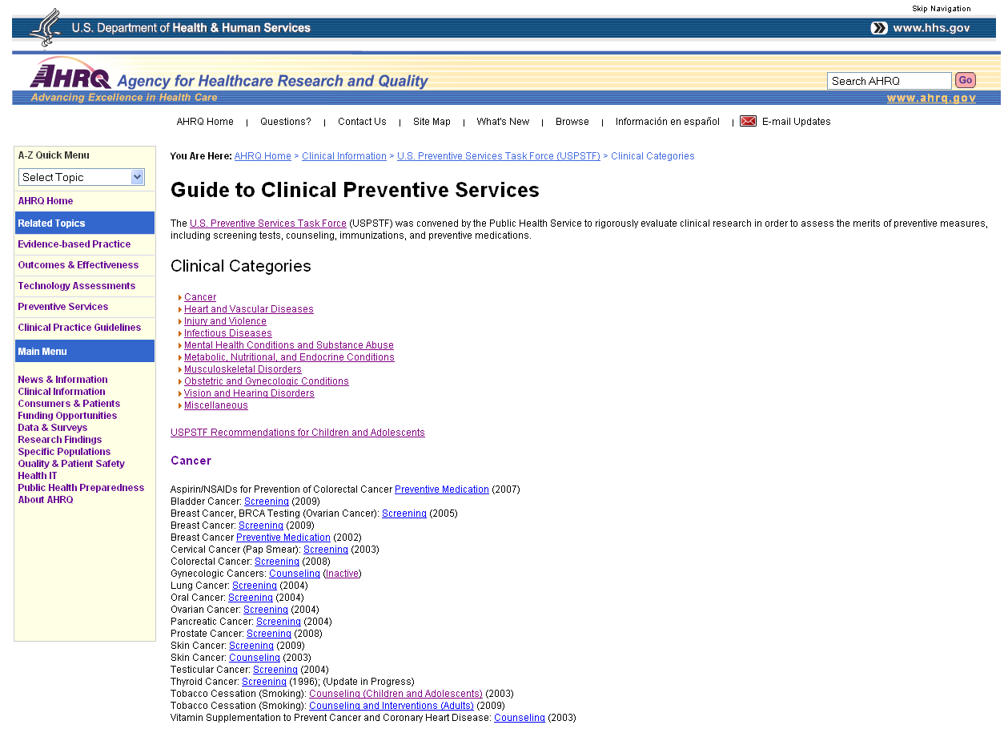
Notes:
AHRQ recommendations are particularly important to some of the projects that will be implemented over the next year, one will have the opportunity to promote system/policies changes that support adherence to the clinical guidelines.

Slide 26

http://www.nrepp.samhsa.gov/
Notes:
NREPP has a variety of interventions including tobacco prevention.

Slide 27
Additional Resources
National Guidelines Clearinghouse http://www.guideline.gov/
Cochrane Collaboration (systematic reviews)
http://www.cochrane.org/reviews/clibintro.htm
Notes:
National Guidelines Clearinghouse lets you search for clinical guidelines by topics.
Cochrane Collaboration, this online library is a collection of evidence-based medicine databases including Cochrane Database of Systematic Reviews, Database of Abstracts of Reviews and Effectiveness (DARE),

Slide 28

Key Take Aways: EBPH Overview
Evidence-based program, policies, and strategies have been proven to work
There are evidence-based resources available online for you to locate programs, policies or strategies that meet your goals
They can save you time and money in implementing these previously developed PPSs
Notes:
Key take ‘aways’
Evidence-based program, policies, and strategies have been proven to work
There are evidence-based resources available online for you to locate programs, policies or strategies that meet your goals
They can save you time and money in implementing these previously developed PPSs

Slide 29
Community Engagement and Partnership
June Ryan

Slide 30
Session Objectives
Define community engagement and describe the benefits and principles.
Know how to assess your audience—know who they are, what they value, and what factors influence their health.
Be able to find resources and methods for collecting data from first-hand (primary) and second-hand (secondary) sources.
Understand the value of using good data sources to drive your program.
Be able to find other groups and agencies that could assist—or that may compete—with your program efforts.

Slide 31

What is Community Engagement?
…the process of working collaboratively with and through groups of people affiliated by geographic proximity, special interest, or similar situations to address issues affecting the well-being of those people. It is a powerful vehicle for bringing about environmental and behavioral changes that will improve the health of the community and its members. It often involves partnerships and coalitions that help mobilize resources and influence systems, change relationships among partners, and serve as catalysts for changing policies, programs, and practices (Principles of Community Engagement- Second Edition, 2011, p. 7).
Notes:
Engaging community members in problem-solving solutions to issues that affect them is one of the fundamental principles of public health. The most effective way to achieve public health goals, especially the elimination of disparities in health status, is to actively engage those experiencing the problems in every aspect of addressing them. Community engagement means involving community members in all activities--from identifying the relevant issues and making decisions about how to address them, to evaluating and sharing the results with the community.
Community engagement can take many forms, and partners can include organized groups, agencies, institutions, or individuals. Collaborators may be engaged in health promotion, research, or policy making.

Slide 32
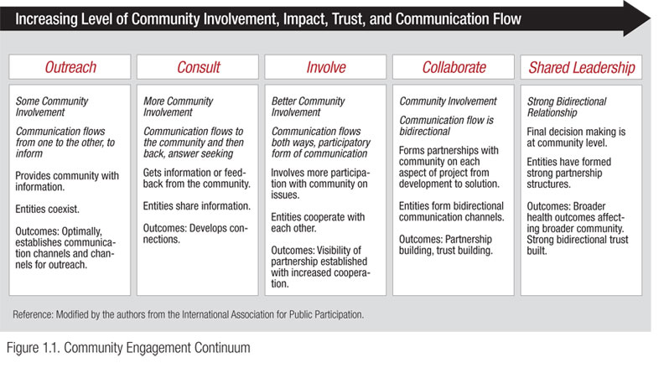
Notes:
Community engagement can also be seen as a continuum of community involvement. Over time, a specific collaboration is likely to move along this continuum toward greater community involvement, and any given collaboration is likely to evolve in other ways, too.
Look at this picture and tell me what you see—I hope you see diversity: age, gender, racial and ethnic differences. Why is this important?
Most notably, while community engagement may be achieved during a time-limited project, it frequently involves — and often evolves into — long-term partnerships that move from the traditional focus on a single health issue to address a range of social, economic, political, and environmental factors that affect health.

Slide 33
Benefits of Community Engagement
Community Engagement Creates potential:
Focuses on social justice
Helps shape services
Helps build trust
Helps with outreach
Connects people and resources
Develops new leaders
Creates and opportunity for critical reflection
Notes:
Question for Participants: What are some of the benefits of community engagement?
Focuses on social justice: It is through community engagement that community wisdom and science work in tandem to ensure a more balanced set of political, social, economic and cultural priorities, resulting in shared resources and shared power, thus leading to equity and social justice.
Helps shape services: Including a broad array of community residents from the beginning of a planning process will help shape services so they are culturally acceptable and more closely meet specific needs.
Helps build trust: Inviting leadership from community groups will help demonstrate that their participation is valued and that their views will be considered. This can help to build trust, increase communication and create openness to utilizing services.
Helps with outreach: More residents will feel involved with community activities and decisions and will be able to explain or interpret them positively to others. Spreading the word through this informal approach will improve outreach.
Connects people and resources: Community engagement efforts improve connections between individuals, community associations, businesses, and churches, which in turn creates greater community "buy-in."
Develops new leaders: Inviting community members and leaders of community groups into planning processes will help in the identification of champions and development of leaders who understand public health issues.
Creates an opportunity for critical reflection: Community engagement processes provide opportunities for cooperative, co-learning experiences, and critical reflection that benefits from community wisdom.
(Source: Minnesota Department of Health - http://www.health.state.mn.us/communityeng/intro/benefits.html)

Slide 34
Principles of Community Engagement
Be clear about the purposes or goals of the engagement effort, and the populations and/or communities you want to engage.
Become knowledgeable about the community’s culture, economic conditions, social networks, political and power structures, norms and values, demographic trends, history, and experience with engagement efforts.
Go into the community, establish relationships, build trust, work with the formal and informal leadership, and seek commitment from community organizations and leaders to create processes for mobilizing the community.
Notes:
Additional Information by Principle:
1 - The implementers of the engagement process need to be able to communicate to the community why their participation is worthwhile.
2 - Learn about the community's perceptions of those initiating the engagement activities. It is important to learn as much about the community as possible, through both qualitative and quantitative methods from as many sources as feasible.
3 - Engagement is based on community support for whatever the process is trying to achieve. Why is it important that we “go into the community”?

Slide 35
Principles of Community Engagement
Remember and accept that collective self-determination is the responsibility and right of all people who comprise a community.
Partnering with the community is necessary to create change and improve health.
All aspects of community engagement must recognize and respect the diversity of the community.
Community engagement can only be sustained by identifying and mobilizing community assets and strengths and by developing the community’s capacity and resources to make decisions and take action.
Notes:
Additional Information by Principle:
4 - No external entity should assume it can bestow upon a community the power to act in its own self-interest. Just because an institution or organization introduces itself into the community does not mean that it is automatically of the community.
5 - The American Heritage Dictionary defines partnership as "a relationship between individuals or groups that is characterized by mutual cooperation and responsibility, as for the achievement of a specified goal."
6 - Awareness of the various cultures of a community and other factors affecting diversity must be paramount in planning, designing, and implementing approaches to engaging a community. Diversity may be related to economic, educational, employment, or health status as well as differences in culture, language, race, ethnicity, age, gender, mobility, literacy, or personal interests.
7 - Community assets include the interests, skills, and experiences of individuals and local organizations as well as the networks of relationships that connect them.

Slide 36
Principles of Community Engagement
Organizations that wish to engage a community as well as individuals seeking to effect change must be prepared to release control of actions or interventions to the community and be flexible enough to meet its changing needs.
Community collaboration requires long-term commitment by the engaging organization and its partners.
Source: Principles of Community Engagement – Second Edition, 2011
Notes:
Additional Information by Principle:
8 - Engaging the community is ultimately about facilitating community-driven action.
9 - Communities and community collaborations differ in their stage of development (refer to the active community engagement continuum). Before individuals and organizations can gain influence and become players and partners in decision making and action steps taken by communities relative to their health, they may need additional resources, knowledge, and skills

Slide 37
Getting Started: Questions To Answer About Your Audience
Which audiences have the greatest cancer burden?
How might you describe your audience? What is their race/ethnicity? Education level(s)? Age ranges? General socioeconomic status?
Where/how do they spend the majority of their time?
What are their health beliefs?
What are their gaps in knowledge or barriers to heath information?
What are their health needs? What do they want with regard
to . . . ? (This may or may not be related to what they value.)
What are the best ways to reach your audience (e.g., looking at community resources)? What is their media access/use?
Notes:
Tie-in from Community Engagement Principles to Needs Assessment: Now that you know the basic principles of community engagement and why it’s important, we are now going to focus on the first principle – getting to know your community, and more specifically, the particular target audience for your program or intervention. The remainder of the presentation will give you practical tips for conducting a needs assessment in your community.
-Begin by taking stock of certain features of your audience.
-Getting information about the knowledge, perceptions, attitudes, motivation, and health practices of a group should come before program planning.
-By writing down some of this information, you can plan better interventions.

Slide 38
Learning About Your Community
Primary sources
Quantitative: Surveys/questionnaires
Qualitative (group): Focus groups, public meetings, direct observation
Qualitative (one-on-one): In-depth interviews with community leaders, interviews with other program planners.
Notes:
Question for Participants: Can someone provide the definition of primary sources and give an example(s)?
-Primary data are gathered straight from the community.
-They can be quantitative or qualitative.
Question for Participants: Who can tell me the difference between quantitative and qualitative data sources, and give an example(s)?
Explain as needed:
-Quantitative data involves numbers and statistics. They include information such as multiple choice or 1- to 2-word answers that are easy to score. Some may say that these data answer the “what” of an issue.
-Qualitative data collection uses questions that cannot be answered by yes or no. It collects information that cannot be easily explained by numbers. It can include nonverbal cues as well. Or observations of the target group. Some say that these data answer the “why” of an issue.
-These data collection methods can also find key members of the community who should be involved in the program planning. For example, community leaders can help describe cultural beliefs. Or they can describe the best way to channel health messages.

Slide 39
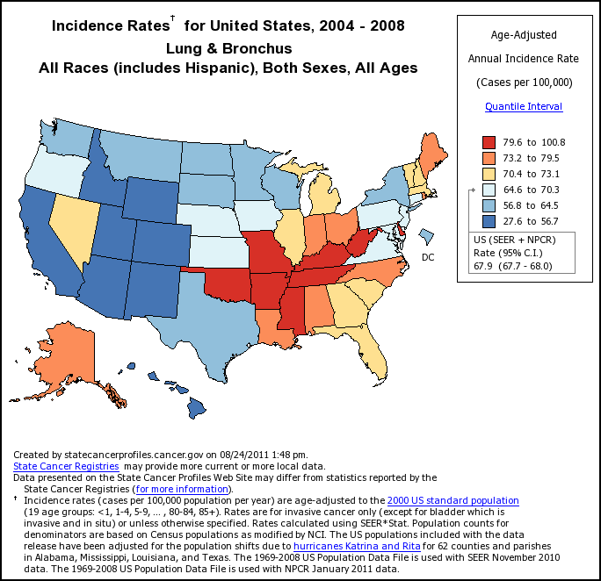
Information Collection
Secondary sources
Health status data: demographics, vital statistics, hospital records, morbidity and mortality reports
Cancer Control P.L.A.N.E.T. State Cancer Profiles (NCI, CDC)
Literature review
Notes:
Most of you will look for secondary data first, but you can gather primary data when you cannot find the answers to your questions.

Slide 40
Useful Data Sources
State Cancer Profiles (Step 1 on Cancer Control P.L.A.N.E.T.): http://statecancerprofiles.cancer.gov
Surveillance, Epidemiology and End Results (SEER) Program: http://seer.cancer.gov
Health Information National Trends Survey (HINTS): http://hints.cancer.gov
U.S. Census Bureau: http://www.census.gov
National Center for Health Statistics: http://www.cdc.gov/nchs
National Program of Cancer Registries (NPCR): http://www.cdc.gov/cancer/npcr
Behavioral Risk Factors Surveillance Survey (BRFSS): http://www.cdc.gov/brfss/index.htm
American Cancer Society’s Facts and Figures: http://www.cancer.org/docroot/STT/stt_0.asp
Data.gov (includes HealthData.gov): http://www.data.gov

Slide 41
Using Data to Engage Coalitions
Recommendations:
Package data in useful manner to help coalition members identify and prioritize programming efforts.
Encourage coalition members to gather, review and use local data.
Remember, data is more than numbers.
Notes:
Remember who your audience is. It may be necessary to package the information differently for different audiences. Can anyone think of an example of this?
One example: charts with numbers and trend lines

Slide 42
Introducing Partners to Evidence: It’s a Process…
Awareness
Educate on the value of using evidence
For the organization
Training
Give partners examples of evidence and applicability
Train partners on tools
Support
Connect partners with available resources and information about evidence-based programs
For the partners
For the people they serve
Offer outcomes to strive for
Notes:
Grantees/Partners may be hesitant to change their ways unless they fully understand the value of using evidence.
Make it meaningful for them.
This is a PROCESS. You want to raise awareness on all levels and assess your buy –in: how ready are people to make these changes
Offer outcomes that they can strive for – help them understand the importance of this approach
42

Slide 43
Expectations of Partnership
Work strategically to reach populations most in need
Outline mutually agreed upon goals and expectations
Shared data
Shared responsibility
Report back on actions and impact
Work together to change practice
Notes:
But—one caution. Work with populations or communities that are ready to make a change. It may be necessary to work with a community that is eager to work with you so that you have a success story to share with other communities that may be more reluctant.
43

Slide 44

Barriers
Competing health messages
Unhealthy lifestyles
Other health issues
Other health-enhancing activities
Basic needs
Expenses
Care-taking
Education
Fears, misconceptions, stigma
Notes:
-Along with thinking about potential partners, also think about barriers to your program.
-Be very much aware of other groups that may have competing interests or messages.
These groups do not need to be promoting unhealthy lifestyles, such as eating junk food or smoking. But they may be trying to promote another health issue that affects your audience. For example, you may be competing with groups that raise awareness about heart disease or stroke.-Basic needs, like lack of money or family concerns, may also compete with your health message.
-By knowing more about the competition to your health message such as time, money, education, and interest, you can run more effective programs. The same is true if you can put basic needs into your health message, where possible.
Question for Participants: How can you take into account competing health issues, basic needs, or unhealthy habits when looking for project partners? One suggestion: conduct a community needs assessment to get buy in for the issues.

Slide 45
Key Take Aways: Community Engagement/Partnership
Notes:
Before we finish, let’s take just a couple of minutes to summarize. Since I have been doing much of the talking, let’s hear from you--

Slide 46
Additional Resources
Principles of Community Engagement, Second Edition: http://www.atsdr.cdc.gov/communityengagement
Using What Works:
http://cancercontrol.cancer.gov/use_what_works/start.htm
Minnesota Department of Health: http://www.health.state.mn.us/communityeng

Slide 47

Questions or Comments?
Notes:
47

Slide 48
Program Adaptation and Implementation
Evelyn Gonzalez

Slide 49
Session Objectives
Define adaptation
Determine what needs to be changed in your EBP through program planning and brainstorming activities
Describe what can and cannot be changed
Define phases of implementation
Discuss important factors or tasks in each phase
Notes:
Today’s session objectives:
Define adaptation
Determine what needs to be changed in your evidence-based program through program planning and
brainstorming activities
Describe what can be changed and what cannot be changed in your program
Define phases of implementation (pre-implementation, implementation, maintenance)
Discuss important factors or tasks in each phase

Slide 50
Adaptation
Adaptation: the process or state of changing to fit new circumstances or conditions, or the resulting change
Extent* to which an innovation is changed or modified by the implementer in the process of its adoption and implementation
*Rogers, 2003, Diffusion of innovations (5th ed.). New York: Free Press.
Notes:
What is it that we mean when we use the term “adaptation?”
Adaptation refers to the “process or state of changing to fit new circumstances or conditions, or the resulting change.”
When we use the term adaptation in relation to evidence-based programs, we simply mean the extent to which an innovation is changed or modified by the implementer in the process of its adoption and implementation.
DISCUSSION QUESTION- Given this definition, what is the difference between adapting an evidence-based program and changing it?

Slide 51
Program Fidelity
Fidelity: faithfulness to the elements of the program, in the way it was intended to be delivered
Components of fidelity*:
Adherence to program protocol/implementation guide
Dose or amount of program delivered
Quality of program delivery, and
Participant reaction and acceptance
* Rabin, Brownson, Haire-Joshu, Kreuter, Weaver. A glossary for dissemination and implementation research in health. Journal of Public Health Management Practice, 2008, 14(2), 117–123.
Notes:
Program fidelity refers to the elements of a program that are delivered in the way that they were intended.
Components of fidelity include:
Adherence to program protocol/implementation guide
Dose or amount of program delivered
Quality of program delivery, and
Participant reaction and acceptance

Slide 52
Program Fidelity
Core elements*: required components that represent the theory and internal logic of the intervention and most likely produce the intervention’s effectiveness
Key process steps: required steps that are conducted to contribute to the intervention’s effectiveness
Critical steps taken in program implementation in the program’s methods section or implementation protocol
*Eke, Neumann, Wilkes, Jones. Preparing effective behavioral interventions
to be used by prevention providers: the role of researchers during HIV Prevention Research Trials. AIDS Education & Prevention 2006, 18(4 Suppl A):44-58.
Notes:
All evidence-based programs must maintain their fidelity. These required components are very important. They represent the theory and internal logic of the intervention and most likely produce the intervention’s effectiveness.

Slide 53
Activity: Choosing Core Elements of a Program
Read the handout with the Body & Soul description paragraph about “The Program”
Identify: What are the program core elements?

Slide 54
Body and Soul Program Core Elements
Project Committee
Kick-off event
At least 3 church-wide nutrition events
At least 1 additional event involving the pastor
At least 1 church food habit change (policy change)
2 motivational counseling calls by volunteers to each participant
Notes:
This is a list of the core elements of the Body & Soul program. Remember core elements are the required components that represent the theory and internal logic of the intervention and most likely produce the intervention’s effectiveness. For the Body & Soul Program, these include:
Project Committee
Kick-off event
At least 3 church-wide nutrition events
At least 1 additional event involving the pastor
At least 1 church food habit change (policy change)
2 motivational counseling calls by volunteers to each participant

Slide 55

Step 1: Identifying What Can Be Modified?
Can
Cannot
Names
Pictures/testimonials
Wording
Location
Incentives
Timeline
Health topic
Deletion of key components
Insertion of key components
Theoretical foundation
Notes:
DISCUSSION QUESTION- Based on the example provide, what elements can be modified?

Slide 56
Acceptable Modifications
Changing language
Translating and/or modifying vocabulary
Replacing cultural references
Modifying some aspects of activities
Adding relevant, evidence-based content
O’Connor, C., Small, S.A. & Cooney, S.M. (2007). Program fidelity and adaptation: Meeting local needs without compromising program effectiveness. What Works, Wisconsin Research to Practice Series, 4. Madison, WI: University of Wisconsin–Madison/Extension.
Notes:
When we are looking to make changes to evidence-based interventions, there are some changes that are more acceptable than others. For example, changing language, replacing cultural references, modifying some aspects of activities such as physical contact, and/or adding relevant, evidence-based content to make the program more appealing to participants.

Slide 57
Risky or Unacceptable Modifications
Reducing the number or length of sessions
Lowering the level of participant engagement
Eliminating key messages or skills learned
Removing topics
Using few or inadequately trained staff
Notes:
Other changes are risky or unacceptable. These changes impact the fidelity of the program. Examples of these types of changes include: reducing the number or length of sessions, lowering the level of participant engagement, eliminating key messages or skills learned, removing topics, using staff or volunteers who are not adequately trained or qualified, and/or using fewer staff members than recommended.
Remember, the reason to choose an evidence-based program is that it has been evaluated for usability and effectiveness. The more changes you make to the original program, the less likely you are to get the original program results.

Slide 58
Step 3: Making the Modifications
Brand materials with your contact information.
Replace general pictures and drawings with ones that reflect your audience’s culture.
Think about the best media and channels that should be used to publicize your program.
See UWW Module 4 - Handout #3: Communication Channels and Activities: Pros and Cons. -- http://cancercontrol.cancer.gov/use_what_works/mod4/Module_4_Handout_3.pdf
Notes:
Once you know what changes you’ll be making, it’s time to get started! When you make modifications to an existing program there are a few things to keep in mind:
Brand materials with your contact information. (This includes contact names, mail and e-mail addresses, and phone numbers).
Replace general pictures and drawings with ones that reflect your audience’s culture.
You may need the help of your partners to distribute your programs materials. Think about the best media and channels that should be used to publicize your program. This is where your needs assessment for locations to reach your audience can come in handy. Step 3 of Cancer Control P.L.A.N.E.T. also gives suggestions for effective communications channels.

Slide 59
Making the Modifications, cont’d
Choose incentives that appeal to your audience.
Make a timeline that makes sense based on your resources.
Try not to remove existing or add extra materials.
Use the original health or communication model from the evidence-based program.
Print materials and readability.
See UWW Module 4 - Handout #4: Readability Guidelines -- http://cancercontrol.cancer.gov/use_what_works/mod4/Module_4_Handout_4.pdf
See UWW Module 4 - Handout #5: Key Elements of Plain Language Printed Materials –
http://cancercontrol.cancer.gov/use_what_works/mod4/Module_4_Handout_5.pdf
Notes:
Choose incentives that appeal to your audience. Go to your needs assessment for ideas about what your audience likes to do and what it is that they value.
Make a timeline that makes sense based on your resources. For example, if you have less staff, your program may take longer to conduct than the original program did.
Try not to remove existing or add extra materials.
Use the original health or communication model from the evidence-based program.
Print Materials and Readability. Print materials may play an important role in your program. Measure the reading level of written materials that will be used by your public. If the reading level is too high, be sure to change the wording.

Slide 60
Ensure Effectiveness
Select a program that meets your needs
Ensure staff members are committed to fidelity
Stay true to the duration and intensity of the original program
Avoid program drift
Notes:
Select a program that meets your needs
Ensure staff members are committed to fidelity
Stay true to the duration and intensity of the original program
Avoid program drift

Slide 61
How can technical assistance help?
Find programs that are evidence-based
Plan well-designed programs
Adapt EBP to your organization and audience
Help others in your agency
Updated funding and training opportunities
Notes:
Technical assistance can help in many ways. It can help:
Find programs that are evidence-based
Plan well-designed programs
Adapt EBP to your organization and audience
Help others in your agency get ready to implement and evaluate your new program
Keep you updated on funding and training opportunities

Slide 62
“Public health workers … deserve to get somewhere by design, not just by perseverance.” McKinlay and Marceau
Notes:
“Public health workers … deserve to get somewhere by design, not just by perseverance.” McKinlay and Marceau

Slide 63

Considerations in Implementation
Staff
Training
Resources & Costs
Organizational climate
Partnerships
Notes:
There are lots of things to consider when you start planning for implementation. You will want to look at the staff resources that you have available.
Staff capacity, current workloads and motivation are all things to take a closer look at.
You’ll also need to take a look at your training needs.
Of course, resources and costs are also a big issues to address prior to implementation.
Your organizational climate will also have an impact on implementation. Issues such as leadership, feasibility, and sustainability topics waiting to be addressed.
Finally, take some time to consider the partnerships are needed during implementation. You know that you aren’t going to be able to do it alone, but who are the key stakeholders and players needed to make this program successful?
Taking the time to appropriately plan now will save you time and resources later on.

Slide 64
Pre-Implementation
Hiring staff or recruiting volunteers
Program staff orientation
Intervention overview
Materials
Logistics
Notes:
Now, let’s look at the tasks that need to be accomplished during each phase of implementation. There’s a lot to do in the pre-implementation phase.
In the pre-implementations phase, you will begin by hiring staff and/or recruiting necessary volunteers. Once in place, program staff will need an understanding of the program- what is it and how is this going to work? Staff orientation should cover the intervention overview (e.g., components, outcomes), materials, and logistics.

Slide 65
Pre-Implementation
Training
Intervention (e.g., core elements)
Logistics for each component
Necessary knowledge about topic
Necessary skills for program
Technical assistance
Program developers or interventionist
Program materials/components
Updating or adapting materials/components
Notes:
Training and technical assistance also take center stage in the pre-implementation phase. Training will focus on the intervention itself, logistics for each component, the knowledge necessary about the topic, and any skills needed for the program (i.e. counseling/education, computer, etc.)
Technical assistance focuses on the program developers or interventionists and updating or adapting program materials and/or components.

Slide 66
Pre-Implementation
Enlist community/stakeholder input
Best outreach/recruitment strategies
Estimate number in target population
Incorporate previous needs assessment data
Conduct formative research on any adapted materials
Feedback from expert panel
Focus groups/discussion with target populations
Pilot testing
Notes:
Not quite done yet with pre-implementation. In this stage, you also:
Enlist community/stakeholder input
Best outreach/recruitment strategies
Estimate number in target population
Incorporate previous needs assessment data
Conduct formative research on any adapted materials
Feedback from expert panel
Focus groups/discussion with target populations
Pilot testing

Slide 67
Implementation
Conduct program promotion and/or recruitment
Track implementation of core elements of program (e.g., each component, length/# of sessions)
Collect process measures (e.g., attendance, timeliness of activities, etc.)
Monitor program activities
Notes:
Now that the pre-implementation work is complete, it’s time to move to the next phase- implementation.
In implementation, you will:
Conduct program promotion and/or recruitment
Track implementation of core elements of program (e.g., each component, length/# of sessions)
Collect process measures (e.g., attendance, timeliness of activities, etc.)
Monitor program activities

Slide 68
Examples of Maintenance Activities
Referrals for further service, if needed
Seek additional funding
Secure a program champion
Make program a part of organizational services
Notes:
Here are some examples of maintenance activities:
Referrals for further service, if needed
Seek additional funding
Secure a program champion
Make program a part of organizational services

Slide 69
Key Take Aways: Adaptation/Implementation
Know your audience and your goals/objectives
Being able to conduct a program doesn’t mean you should do the program – feasibility
Program planning and brainstorming activities can help you determine what needs to be changed in your program.
There are things that can be changed and things that cannot. Know what’s what!
Try to adhere to original program to preserve fidelity.
Evaluate adaptations to the program to determine effectiveness.
Notes:
Some important things to keep in mind:
Program planning and brainstorming activities can help you determine what needs to be changed in your program.
There are things that can be changed and things that cannot. Know what’s what!
Have a plan! Know what’s going to happen when and by whom.

Slide 70
Resources – Adaptation & Implementation
Guidelines for Choosing and Adapting Programs http://rtips.cancer.gov/rtips/reference/adaptation_guidelines.pdf
Evidence-Based Public Health, Ross Brownson et.al., Oxford University Press, 2003

Slide 71

Questions or Comments?
Notes:
71

Slide 72
Evaluation
Alton Hart
Cindy Vinson

Slide 73
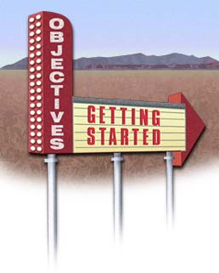
Session Objectives
Know how to use different methods of evaluation.
Be able to match your evaluation methods with your program objectives.
Know where to apply methods for evaluation in the different stages of your program.

Slide 74
Definition of Evaluation
“Evaluation is the systematic acquisition and assessment of information to provide useful feedback about some object”
Notes:
What is program evaluation?
“The examination of the worth, merit, or significance of an object.” Scriven, 1998
“The systematic collection of information about the activities, characteristics, and outcomes of programs to make judgments about the program, improve program effectiveness, and/or inform decisions about future program development.” Patton, 1997

Slide 75
Question
Give me an example of an evaluation activity
you did this past month.

Slide 76
Types of Evaluation
Formative
Needs assessment
Evaluability assessment
Structured conceptualization (usability)
Implementation evaluation
Process evaluation
Summative
Outcome evaluation
Impact evaluation
Cost-effectiveness and Cost-benefit analysis
Secondary analysis
Meta-analysis
Notes:
Regardless of the type of evaluation, the evaluation “should serve a useful purpose, be conducted in an ethical manner and produce accurate findings.” CDC, 2005
Also, “evaluation findings should be used both to make decisions about program implementation and to improve program effectiveness.” CDC, 2005

Slide 77
The Purposes of Evaluation
Evaluation helps you to:
See whether program objectives were met
Document the strengths and weaknesses of the program
Have data for keeping good financial records
Improve staff member skills in planning, conducting, and evaluating activities
Meet grant or contract requirements
Promote public relations and awareness
Find out the extent to which a program or its components are appropriate for other populations or settings
Add to the knowledge base of health education program design
Identify hypotheses about behavior for future evaluation.
From Windsor et al., 1994
Notes:
Why Evaluate Public Health Programs?
Some reasons:
To monitor progress toward the program’s goals.
To determine whether program components are producing the desired progress on outcomes.
To permit comparisons among groups, particularly among populations with disproportionately high risk factors and adverse health outcomes.
To justify the need for further funding and support.
To find opportunities for continuous quality improvement.
To ensure that effective programs are maintained and resources are not wasted on ineffective programs.
CDC, 2005

Slide 78
Evaluate From the Beginning
Evaluation begins with your audience or needs assessment.
Use the data you collect about your audience to find out how it is affected by the health issue before your intervention. This is your “baseline.”
The baseline will help you to measure the effect that your program has on your audience.
The outcome of your program has no value if you do not know where your audience was before the start of the program.
Notes:
How do ensure the best focus for your evaluation?
A key aspect of developing the focus for your evaluation is to make sure you have identified and engaged your audience or stakeholders who care about the questions that will be addressed by your intervention

Slide 79
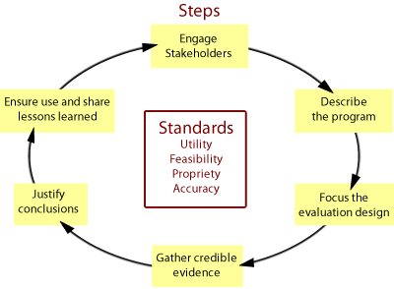
CDC Framework for Program Evaluation in Public Health
Notes:
Program evaluation is 1 or 10 essential public health services
In 1999, the CDC published the Framework for Program Evaluation in Public Health
Six steps and four sets of standards
Six Steps
Engage stakeholders
Describe the program
Focus the evaluation design
Gather credible evidence
Justify conclusions
Ensure use and share lessons learned
Logic of CDC Framework
“Good evaluation does not merely gather accurate evidence and draw valid conclusions, but produces results that are used to make a difference.” CDC, 2005

Slide 80
Program Planning and Evaluation
Needs
Analysis
Program Evaluation
Planning
Audience
Analysis
Program Development
Program Implementation
Program Maintenance
Evaluation
Notes:
How is evaluation different from (basic) research?
Research seeks to prove; evaluation seeks to improve.”
Framework different from the scientific method
Ongoing in terms of timing
Multiple sources
Incorporates changes and accounts for circumstances
Feedback to stakeholders and dissemination to interested audiences
CDC, 2005

Slide 81


Pre- and Post-Evaluation
You may develop a way to compare the baseline data from the needs assessment with the final outcome of your program. This will let you see if you have achieved your objectives.
Notes:
Remember, the key purpose of program evaluation in public health is to improve practice….

Slide 82

Program Objectives and Evaluation
Your objectives should be measurable so that they can be evaluated
The evaluation should be in line with your SMART objectives
Notes:
SMART Objectives
Specific-objectives should specify what they want to achieve
Measurable-you should be able to measure whether you are meeting the objective or not
Achievable-are the objectives you set attainable?
Realistic-Can you realistically achieve the objectives with the resources you have?
Time-When do you want to achieve the set objectives

Slide 83
Notes:
Establishing clear objectives at the beginning of a program will create a roadmap for systematic inquiry or data collection.
Clear objectives force you to think about the results of your intervention and how you will make judgments about the program, improve program effectiveness, and/or inform decisions about future program development

Slide 84
Evaluation Procedure
Planning | Develop the questions, consult with the program stakeholders or resources, make a timeline.
Data Collection | Pilot testing. How will the questions be asked? Who will ask them?
Data Analysis | Who will analyze the data and how?
Reporting | Who will report and how? Who will receive the data and when? How will it affect the program?
Application | How could your results be applied in other places?
Notes:
This slide further highlights the importance of taking a systematic approach to program evaluation and giving thought to each step in the process.

Slide 85
Process Evaluation
Process evaluation can find problems early on in the program.
It includes an assessment of the staff, budget review, and how well the program is doing overall.
For this kind of evaluation, it may be useful to keep a log sheet to record each of your activities.
Common data collection methods: databases, registration sheets, surveys, and interviews
From Windsor et al., 1994

Slide 86
Impact Evaluation
Impact evaluation can tell if the program has a short-term effect on the behavior, knowledge, and attitudes of your population.
It also measures the extent to which you have met your objectives.
Assesses if the program has a short-term effect on awareness, knowledge, behavior and attitudes of your population or environmental/policy changes
Common data collection methods: surveys, interviews, focus groups, observation
From Green and Kreuter, 1991

Slide 87
Outcome Evaluation
Assesses if the long-term program goals were met
It can measure sustained program changes like sustained behavior or policy change, institutionalization, or a decrease in disease incidence
It can also measure longer term changes in rates of illness or death, as well as in the health status of your population
Common data collection methods: program records, hospital or health department statistics on behavior, diseases, disabilities, or deaths
From McKenzie & Smeltzer, 1997

Slide 88
Example of Evaluation Data
Sample process evaluation data include:
meeting of all of the process tasks you planned
number of participants
number of workshops on healthy eating conducted by your church
number of peer educator sessions done
overall satisfaction with the program
Sample short-term outcome evaluation data include:
increase in knowledge about risk factors for breast cancer
behavior (i.e., exercise for 30 minutes 5 days per week, eating fruits and vegetables, women who get a mammography)
new policy to have healthy foods at worksite events

Slide 89
Body & Soul Replication Evaluation Methods
Type of Evaluation | Evaluation Question | Data | Data Collection Method
Process Evaluation | How many people participated in the program? (reach) | Number of participants by session | Session sign in sheet
Process Evaluation | Were all 4 core elements of the program implemented? (fidelity) | Pastor involved Church activity Church environment Peer education | Activity log of events in each core element (date, event, description, participants, etc.)
Process Evaluation | What was the reaction to the program? What program materials were adapted? | Satisfaction, attitudes about program Summary of adaptations | Participant survey (after the program) Staff logs and interviews
Short term Outcome Evaluation | What changes in eating of fruits and vegetables have occurred? What changes in church policies for healthy eating have taken place? | Eating of fruits and vegetables Policies | Survey of participants (after the program) about healthy eating Review of church policy

Slide 90
Evaluating Adapted Programs
How was the original program evaluated?
If original evaluation is poor, can it be improved?
How much have you adapted the program?
The more you change the program, the more need for rigorous outcome evaluation
What is appropriate for your audience and your resources?

Slide 91
Pilot Testing
A pilot test is a practice run using a small group who are similar to your target audience.
It will help you identify problems before you commit.
Use evaluation results to modify program before you carry it out with wider audience.

Slide 92
Replicating the Evaluation
Evidence-based programs have already done some type of evaluation.
Look to see how the program was evaluated before. Try to use the same methods.
Tip: You are not replicating the research study, only the program.

Slide 93
Evaluation Methods
Evaluation methods can be found in journal articles about the original study.
Contacting the project officer or investigator for your selected program can also be helpful.
This person can give you input on any challenges or obstacles you may find when doing the evaluation.

Slide 94
Evaluation Results
Formally share report with stakeholders
Publish (public health associations, websites, community papers)
Celebrate your results
Use results for ongoing program planning

Slide 95
Key Take Aways: Evaluation
Your Thoughts?

Slide 96
Resources - Evaluation
CDC Evaluation Resources
www.cdc.gov/eval/resources/index.htm
American Evaluation Association
www.eval.org
Notes:
The CDC has done a fabulous job of cataloging evaluation resources. If you go to this link you will find a listing of step-by-step guides, manuals for specific evaluation steps and listings of evaluation organizations.
The AEA site also has a library of resources with presentation from their conferences that is very useful.

Slide 97

EBPH Questions and Discussion

